Slide 1
Basics of Spring Boot
Bala Nagarajan

Slide 2
Topics covered
What is Spring Boot ? Why we need Spring Boot ?
About STS – Spring Tool Suite.
Basics of Spring Boot to develop end to end application
Spring Boot Features
Configuration Involved
Different ways of creating spring boot application
How to create Microservices using Spring Boot.
Microservices – Design Pattern
Sample code - example

Slide 3
What is Spring Boot ? Spring framework problems :
What ? - Spring Boot is nothing but something helps to boot strap Spring framework for building your enterprise applications. Spring Boot it’s easy to create stand alone, production grade spring based applications that you can “just run”. Tool that creates Spring Based applications.
Why not plain Spring ? - It’s an application framework, provides the template to build enterprise applications / Modular programming – just concentrate on modules – Programming and configuration model. Provides Infrastructure support (helps to integrate with Hibernate / struts / Mongo DB ..other existing frameworks).
Problems: Huge Framework / Multiple setup steps (to integrate with any existing frameworks) – you need to understand the various configuration details/steps / Multiple Configuration steps / Multiple steps to build and deploy.
If we overcome these problems, Spring framework is a beautiful framework. Spring boot helps to overcome these hurdles to build a production ready spring applications.

Slide 4
What spring boot offers ?
Spring boot is opinionated – start from one point and try to improve / add from that. With Spring boot it helps for easy configuration / You can build Standalone application (With regular spring application is not standalone – you need to build the web application – build WAR and deploy in Tomcat or other App servers). Whereas in Spring boot helps to build the standalone application (PRODUCTION ready).

Slide 5
About STS – Spring Tool Suite. - Setup
STS helps to develop the Spring boot application end to end
Download the STS – spring.io
Using Maven going to build all dependencies

Slide 6
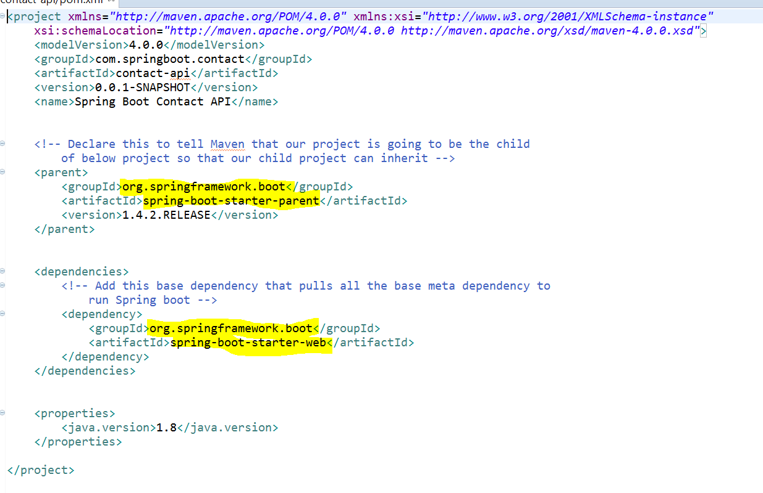
Creating Spring Boot Project
Multiple approaches are there to create a Spring boot project, we are going to try each approach.
Step 1: First create a simple MAVEN project
Step 2: After creating the MAVEN project add the below entries in the pom.xml

Slide 7
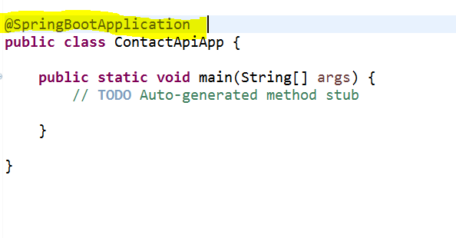
Spring Boot - Application
Step 1: We need to have a main class which basically the boot strap for Spring / We already mentioned that Spring boot doesn’t requires servlet container to deploy. So the main class will be the Boot strap standalone application. We need a way to tell that the defining main class is the spring boot standalone application, for that we need to use the annotation ‘@SpringBootApplication’ (tells that it’s the starting point of the Spring boot application)

Slide 8
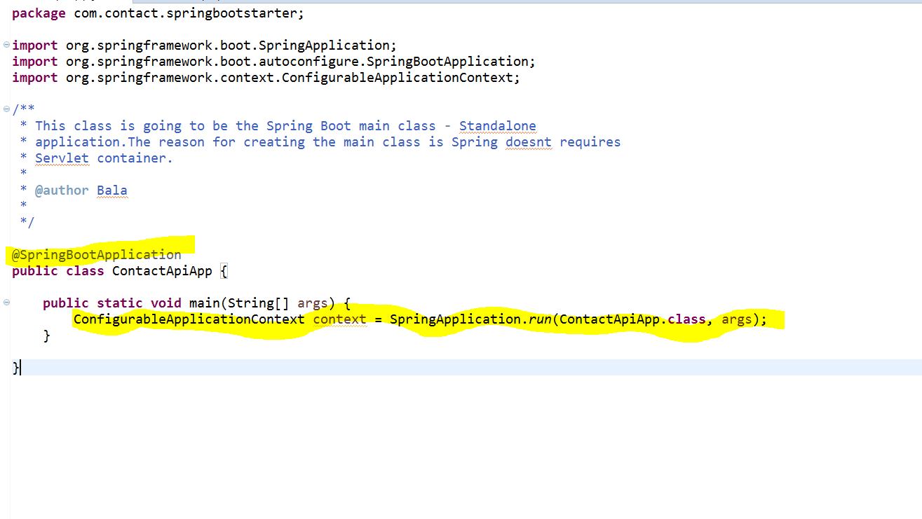
Continued…
Step2 : Next is we need a way to tell the Spring Boot to start the application / create a Servlet container and deploy the app in the created servlet container and host it to handle the request …this seems lots of code to achieve…but the spring boot easily achieve this by

Slide 9
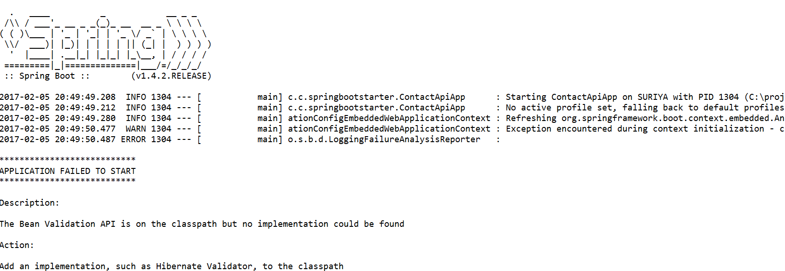
Start the Spring Boot
ConfigurableApplicationContext context = SpringApplication.run(ContactApiApp.class, args);
That’s it the Spring Boot application is ready , when you run this the Spring Boot gets started
See when you started the application , embedded tomcat servlet container started @ port 8080

Slide 10
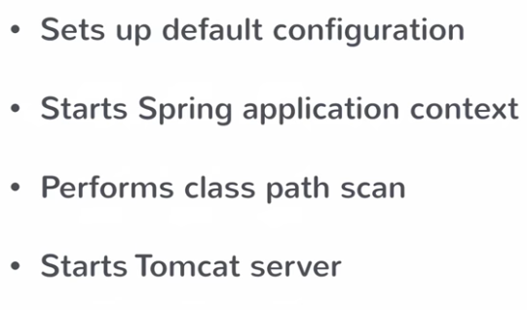
Spring Boot – Startup Steps
The magic line is
It addresses the 80% use case, completes the default configurations. It starts the application context (Spring Container is called as application context, every spring application has application context) so the Spring boot starts the application context. It also performs the class path scan – the way to plugin your custom classes based on the annotation (if its service annotation treat that class as Service class / if it’s a controller class then treat it as a Controller Class) so the spring boot will scan / infers based on the annotations. Finally it starts the Tomcat Server (This came with Spring boot that’s the reason is called as Standalone).

Slide 11
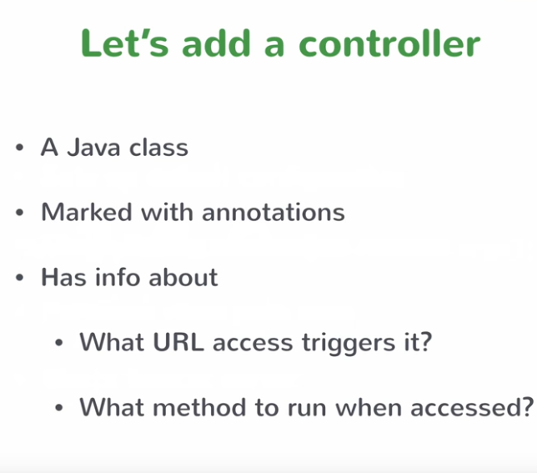
Creating REST Service – Spring Boot

Slide 12
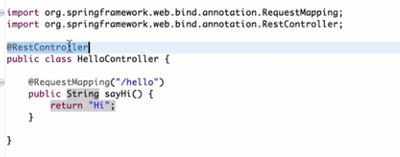
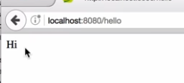
REST – Hello Example
Let’s say you have a URL localhost:8080/hello.So you need to map the ‘/hello’
We are going to create a simple MVC controller. (It’s going to be a REST controller in Spring)
It means you are going to map the methods based on the URL request.
@RequestMapping methods maps to all HTTP URL request to methods
@RestController helps to identify the REST controller

Slide 13
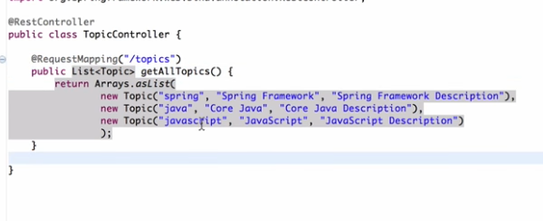
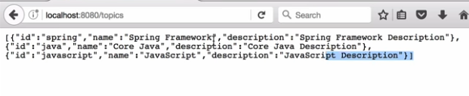
REST returns JSON response

Slide 14


Understanding ‘pom’ configurations
What’s happening in the background, spring does everything for us in the background? Let’s try to understand in details
Let’s start from pom.xml
The spring boot starter parent imports only the configurations / whereas the ‘spring-boot-starter-web’ dependency imports all the necessary spring related jars (spring-core / spring-aop / spring-beans/spring-context/spring-webmvc/embedded tomcat servers….)

Slide 15
Pom configurations - continued
That’s how spring boot provided pre-sets of possible combination jars called as ‘Bill of materials’. Based on the version it picks certain combination of jars so pick the right version of dependency to work with those set of features.
What’s happening here : Embedded Servlet Container
Understanding Embedded Servlet container here: We don’t need to download the tom cat servlet container to deploy our application / Spring boot comes with embedded servlet tom cat container mainly because of convenience / Servlet container configuration steps involved in Tomcat ..Now the servlet configurations should be done as part of application configuration (just like configuring as part of your application source code ...you need to include servlet configurations also. This really helps to achieve the standalone applications. It’s useful for micro services architecture. If you have one big module of service, you can take a pain to deploy the services, if you are using micro services 10 small services then embedded servlet container really helps to deploy it for you. These are the following reasons Spring boot comes with servlet container, if you want to change the servlet container then you need to include the dependency in your code base.

Slide 16
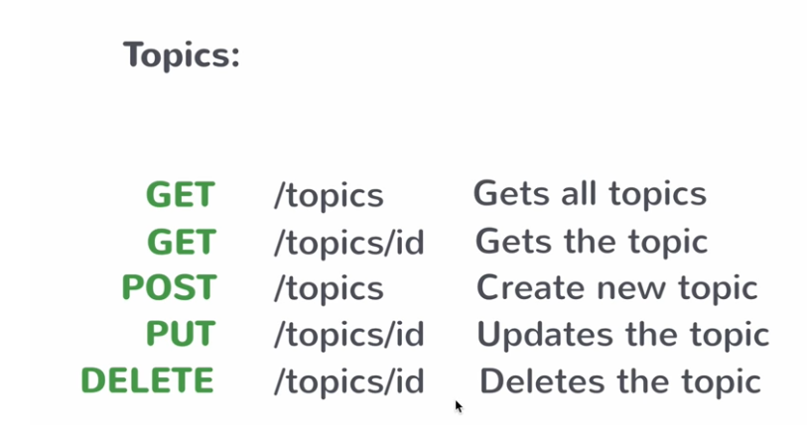
REST - Basics

Slide 17
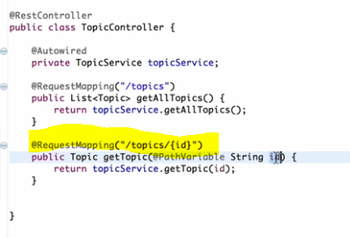
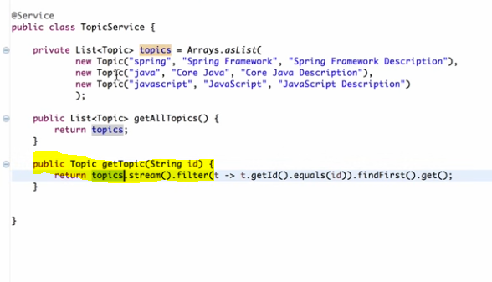
Example – Microservice - REST service

Slide 18

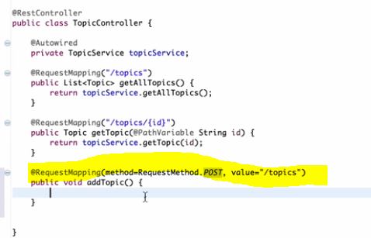
Example – Microservice - REST service
Creating new resource with POST:

Slide 19
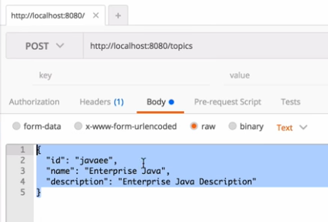
REST Service - Implementation
Constructing the body

Slide 20
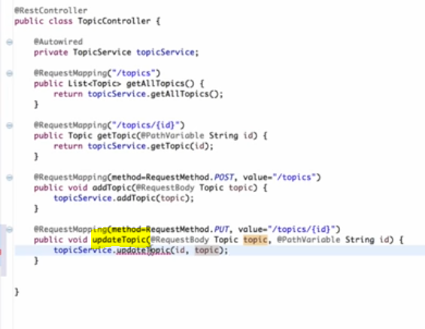
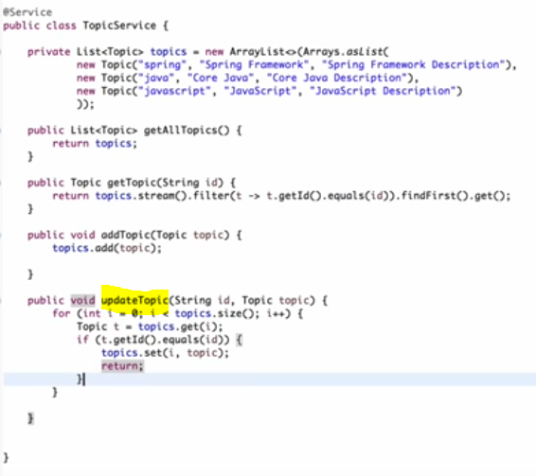
REST Service - implementation
Implementing Update and Delete

Slide 21
Different ways for creating Spring Boot application
Spring Initializr – start.spring.io
Spring Boot CLI – Using groovy scripts you can create spring boot application
STS IDE – Create new Spring Boot application.
Spring Boot Actuator
Bunch of monitors helps to monitor your spring boot application. Go to ‘start.spring.io’

Slide 22
References
Microservices Design pattern – Best practices http://blog.arungupta.me/microservice-design-patterns/
Spring Boot :
https://javabrains.thinkific.com/courses/springboot-quickstart

